Slide 1
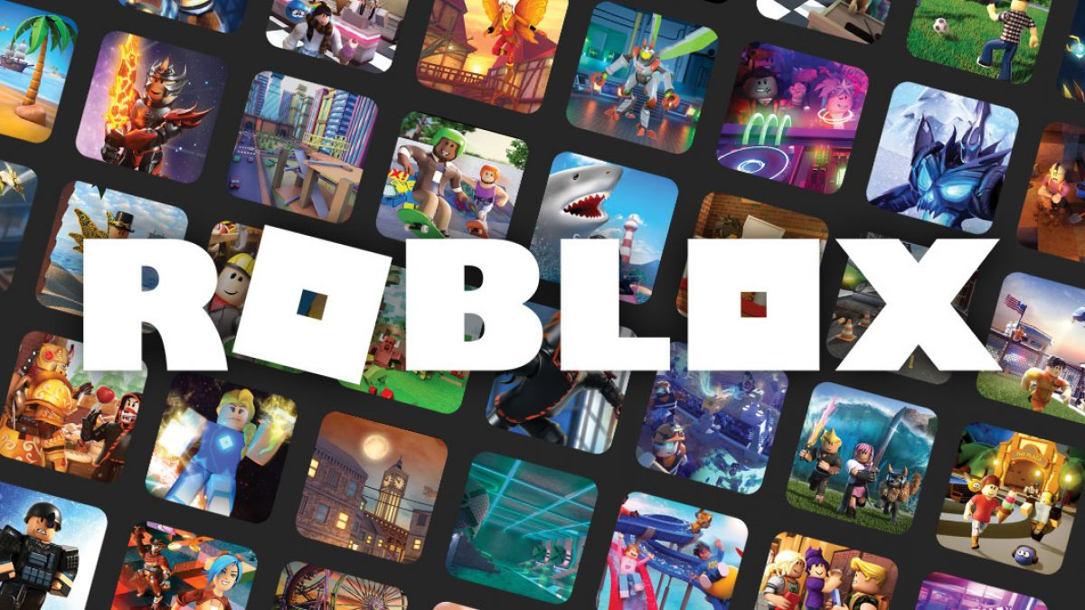
Machine Learning
University of Denver Data Analytics Bootcamp
Final Project
Tuesday, June 1, 2021
Presented by: Alyson Amtman, Kim Christensen, Sara Kayhan, Swati Oberoi Dham, Felix Pronove, Aishwarya Rao, Joey Riebel

Slide 2
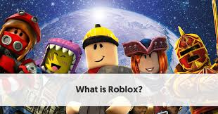
Recall: What is Roblox?
Interactive gaming platform and game creation system that allows users to program games and play games created by other users.
Roblox is ranked as one of the top online entertainment platforms for audiences under the age of 18
Notes:
Felix
Roblox is an online game platform and game creation system developed by the Roblox Corporation. It allows users to program games and play games created by other users. Founded 2004 and released in 2006, the platform hosts user-created games of multiple genres coded in the programming language Lua. For most of Roblox's history, it was relatively small, both as a platform and a company, due to the co-founders lack of interest in press coverage and it being "lost among the crowd" Roblox began to grow rapidly in the second half of the 2010s, and this growth has been accentuated by the COVID-19 pandemic.
Roblox is free-to-play, with in-game purchases available through a virtual currency called "Robux". As of August 2020, Roblox had over 164 million monthly active users, with it being played by over half of all children under the age of 16 in the United States. As of March 2021 it IPO’d at $38B as a company (RBLX) on the stock exchange.

Slide 3
Project Objective
Purpose?
Give users a resource to improve their potential Roblox game’s popularity amongst the desired audience
What we offer:
Create a model that predicts how well a game will resonate with its audience based on key inputs
Notes:
Joey
The objective for this project was to give users a resource to improve their potential Roblox game’s popularity for a targeted audience by creating a model that predicts how well a game will resonate with its audience.
I think this could be a great resource for someone just dabbling in the game development world by giving them an additional opinion and support for their idea.

Slide 4
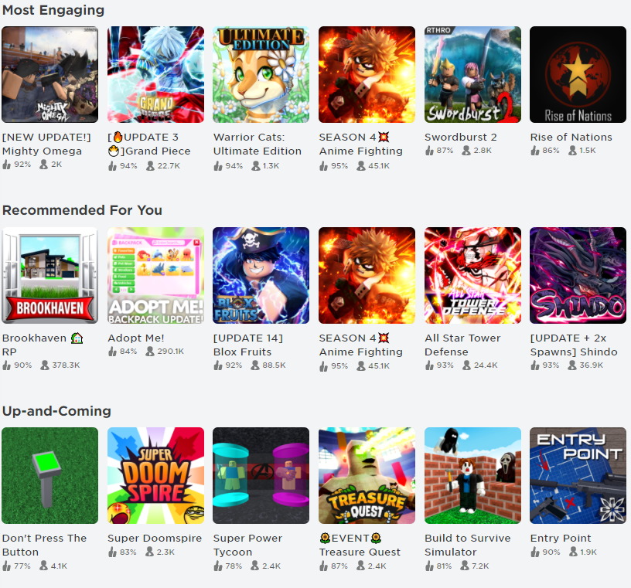
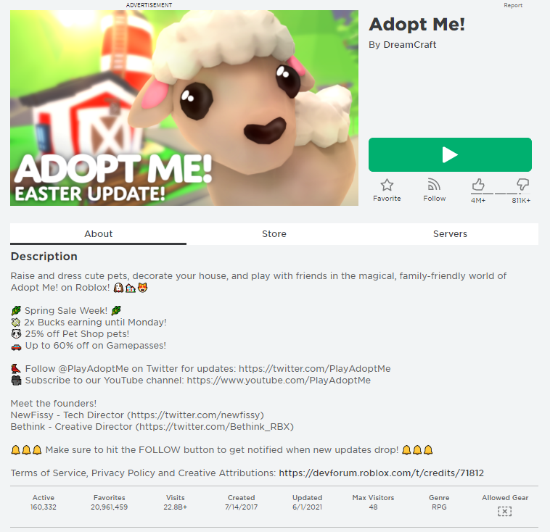
Data Sources
Roblox Website
Game Page
Notes:
Alyson/Felix
Expanding on our previous project, we determined scrape information on the various games in each category and dove into each page and grab more statistics across all games.

Slide 5

Presentation of Roblox Deployment
Notes:
Swati - deployment

Slide 6
Machine Learning
Data Cleaning
Scale to values/day
Remove characters
Models
Flask app
Saved models loaded
1: Visitors Per Day
Train R²: 0.97235
Test R²: 0.93160
Website
Predict success of game based on inputs:
Title
Description
Max # Visitors
Output:
Predicted Success
Data from Roblox website:
Game
Title
Description
Date Created
Category (Award)
Likes
Dislikes
Total Visitors
Max # Visitors
Genre
2: Likes Per Day
Train R²: 0.94471
Test R²: 0.72567
3: Dislikes Per Day
Train R²: 0.89090
Test R²: 0.80017
4: Ratings Per Day
Train R²: 0.94868
Test R²: 0.73777
5: Favorites Per Day
Train R²: 0.95942
Test R²: 0.83593
Notes:
Kim

Slide 7
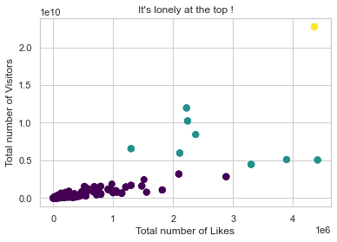
Visuals - K-Means Cluster (Unsupervised Learning)
Notes:
Swati
Here we used Unsupervised machine learning algorithms to find out if games can be created into groups / clusters

Slide 8
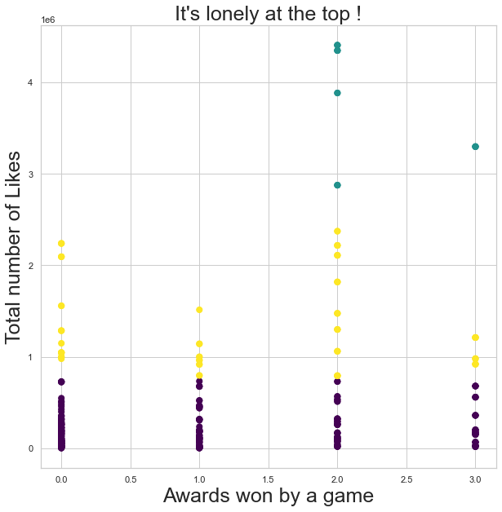
Visuals - K-Means Cluster (Unsupervised Learning)
Notes:
Swati
Here again we tried to look at games based on the awards that they are getting.
One can see that if you win at least 2 or more awards , it means your game probably has a large number of likes and since they are correlated - visitors

Slide 9
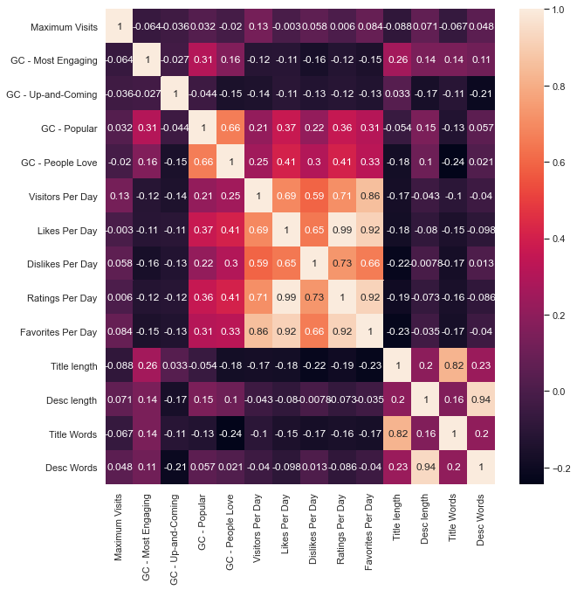
Visuals - Correlation Heatmap
Notes:
Joey
heatmap shows what features are most useful to input into our model and what correlated.
Likes vs rating was one we found very helpful which as you can see has almost a full correlation. This is expected, given that the ratings variable is equal to the sum of the likes and dislikes. More people were likely to select like than dislike, which lends to a correlation very close to 1.
Another interesting correlation is the title length to visits, dislikes, likes, ratings, and favorites. So the more concise your title name is the probability of it being seen more which tends to increase popularity

Slide 10
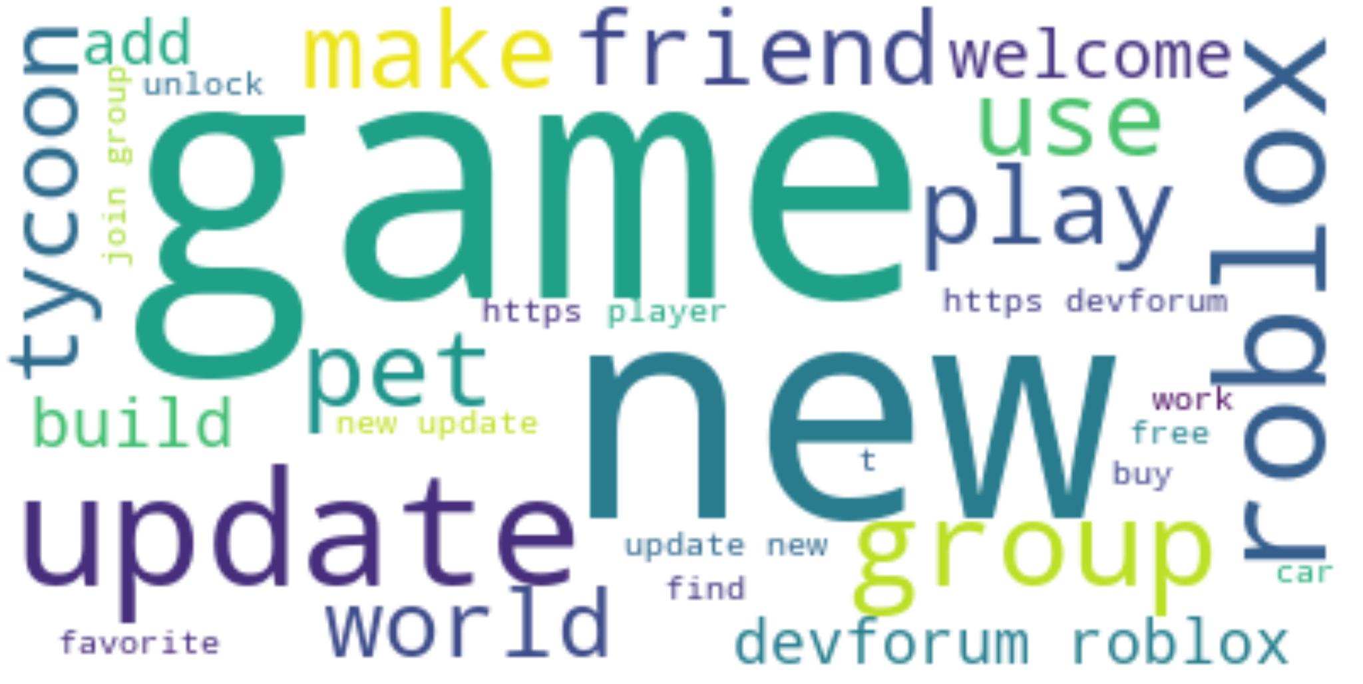
N.L.P. Word Cloud
Notes:
Sara - Natural Language Processing

Slide 11
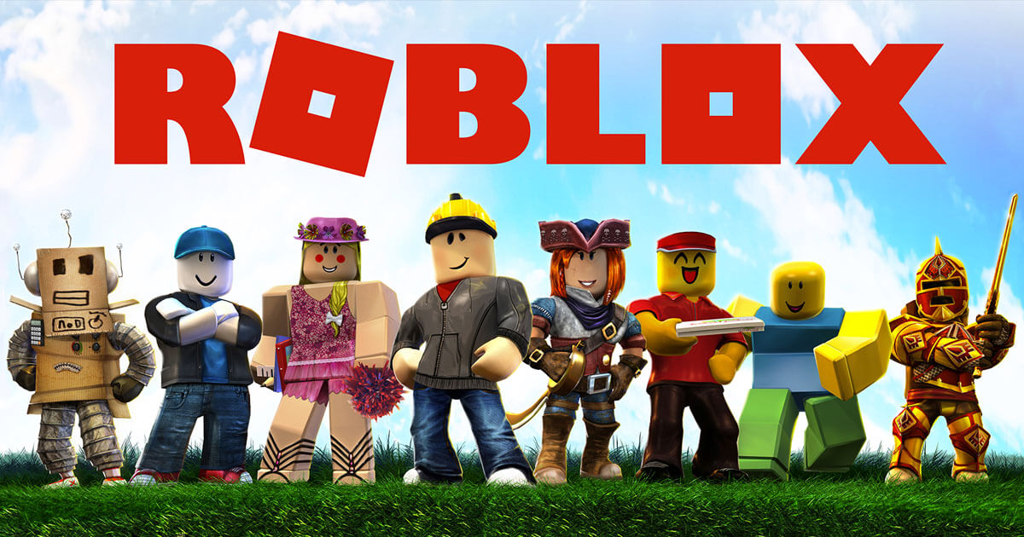
Roblox Roadblocks
Divide and Conquer Team Strategy
Piece-mealing code & merging disconnect
Heroku deployment
Best Path Forward?
Notes:
Ash

Slide 12

Next Steps
Potential future enhancements:
Add in Genre to Predictions
Awards received
Integrated NLP/Model
Notes:
Sara- which awards can be won? The exact category; more in-depth ML DATA WRANGLING & CLEANING

Slide 13
Questions?
Feel free to put them in Slack
Thank you!
Notes:
Sara/Alyson

